Slide 1

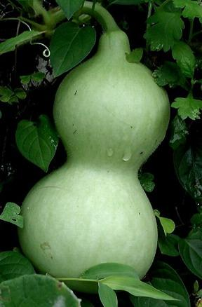
Calabash-android
workshop
Lesson 5: Introduce to query language.

Slide 2
Query function
Query can be use in:
- code
When /^I use query function$/ do
elementsArray = query(“TextView”)
end
- console

Slide 3
Calabash-android console
1. Enter in command line:
calabash-android build <apk>
calabash-android console <apk>
2. Start test server:
start_test_server_in_backgroud
3. Use perform actions and query function in the real time

Slide 4
Query methods
- Filtering based on properties:
query(“button marked:‘text12’”) #buttons contains value in any property
query(“button text:’mytext’”)
- Display view hierarchy:
query(“*”) ; query(“* id:’element’”) #all elements contains property id:element
query(“TextView index:0”) get TextView at index 0
- Filtering based on classes:
query(“android.view.View”)
query(“android.widget.Button”)

Slide 5
Touch function
Sample:
queryRes = query(‘Button id:”button1”’)
touch(queryRes)

Slide 6
Documentation
http://blog.lesspainful.com/2012/12/18/Android-Query/

